Slide 1
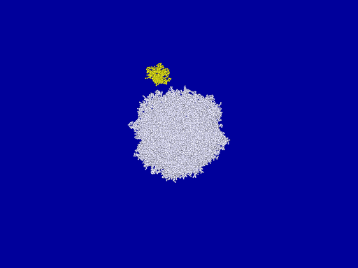
To Be Planetesimals, or Not to Be: That is the Question of Dust Aggregates. Numerical Simulations of Dust Aggregate Collisions
Koji Wada
Planetary Exploration Research Center, Chiba Institute of Technology (PERC/Chitech)
Hidekazu Tanaka, Tetsuo Yamamoto
Institute of Low Temperature Science, Hokkaido University
Toru Suyama
Niigata Science Museum
Hiroshi Kimura
Center for Planetary Science (CPS), Kobe University
Notes:
N=32000+500, ice, ξ_{c} = 8Å, u_{col} = 70 m/s, b=0.39

Slide 2
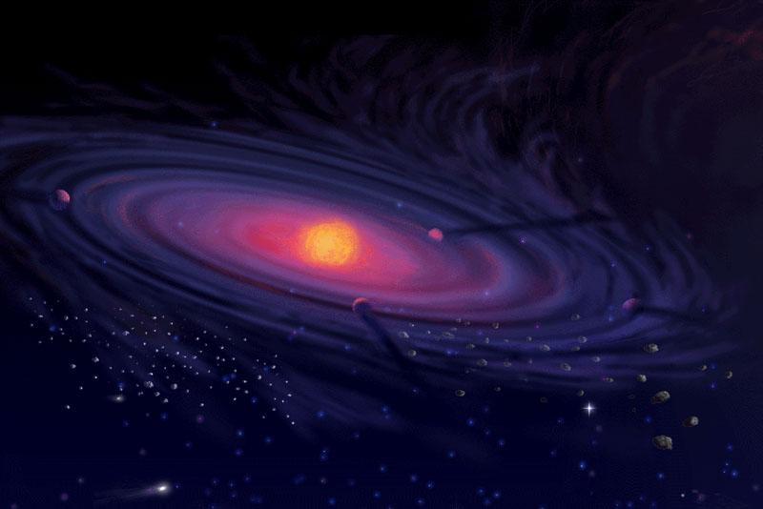
Background
Collisional growth of dust
?
Planetesimal formation
(< μm)
(> km)
Structure evolution of dust aggregates in protoplanetary disks:
When and how are aggregates compressed and/or disrupted ?
Can dust aggregates grow through collisions?
Numerical simulation of dust aggregate collisions!
ダストアグリゲイト衝突の数値シミュレーション！
©NASA

Slide 3
Grain interaction model
Johnson, Kendall and Roberts (1971)
Johnson (1987), Chokshi et al. (1993)
Dominik and Tielens (1995,96)
Wada et al. (2007)
Elastic spheres having surface energy
Normal
Sliding
rolling
twisting
ξ
δ
δ
s
ϕ
Contact & Separation
Energy dissipation
s, ξ, ϕ > critical displacements
Critical slide s_{crit} ~ 1.5 Å (for 0.2 μm quartz)
Critical roll ξ_{crit} ~ 2 Å (or ~30 Å (Heim et al.,1999))
Critical twist ϕ_{crit} ~ 1°
E_{break}
: Energy to break a contact
E_{roll}
: Energy to roll a pair of gains by 90˚

Slide 4
Today’s topics
Can dust grow through collisions?
for Low-velocity collisions
Does “bouncing barrier” for dust growth really exist?
No!
for high-velocity collisions
Do collisions between different-sized aggregate encourage dust growth?
Partly Yes.

Slide 5
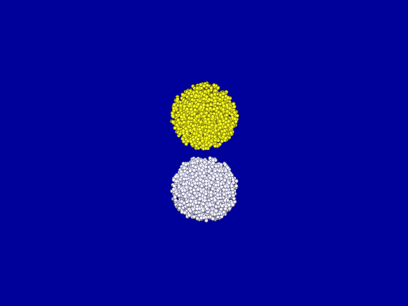
Bouncing Conditions
To bounce, or not to bounce?

Slide 6
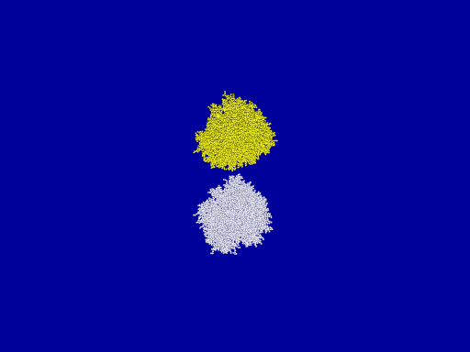
Bouncing Problem
“Bouncing” prevents dust from growing
Previous numerical simulaitons:
Dominik & Tielens 1997;
Wada et al. 2007, 2008, 2009;
Suyama et al. 2008, etc…
No bouncing
Collisional growth is feasible!
BPCA, N=8000+8000, ice, ξ_{c} = 8Å, u_{col} = 70 m/s ( E_{imp} = 42 NE_{break} )

Slide 7
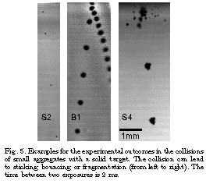
Bouncing in experiments
Güttler et al. 2010
Fragmentation
and/or sticking
Stiking
Bouncing
u_{col}
~ 1 m/s

Slide 8
Bouncing condition
Why bouncing in experiments？
What’s the condition for bouncing？
Hypothesis： Number of contacts controls？
Bouncing would be caused by immobility of particles,
inhibiting energy dissipation.
Aggregates in numerical simulations：
Number of particles in contact with a particle
（Coordination number, C.N.）＝ ２～４, on average
More C.N. in experiments？

Slide 9
Objective
To reveal the dependence on coordination number
for aggregate bouncing
Simulation of aggregate collisions
parameter : Coordination Number (C.N.)
Idea for making required C.N.：
Extracting particles randomly
from close-packed structure (C.N.=12)
aggregates with C.N. = ~12 to ~3

Slide 10
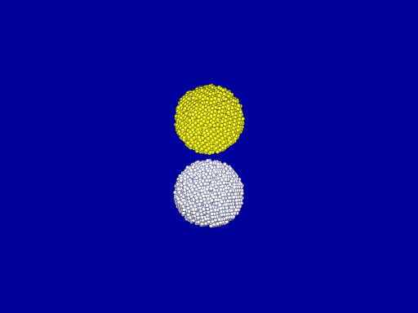
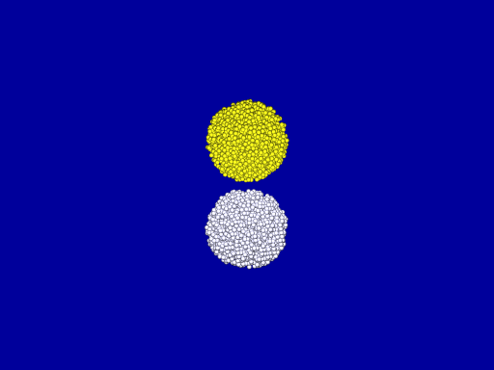
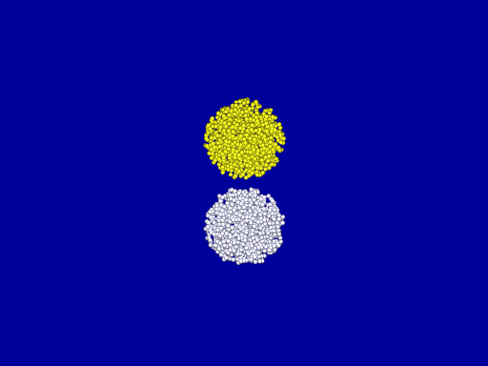
Initial conditions and settings
(hexagonal) close-packed aggregates：
mean C.N. ～ １１
Number of particles：４１９７ （3 types randomly produced）
particle-extracted aggregates：
extraction rate f = 0.05 - 0.75 C.N.～12 (1 – f )
f = 0.2
mean C.N. = 8.8
f = 0.5
mean C.N. = 5.5
f = 0.75
mean C.N. = 2.8
Ice (E = 7.0 GPa, ν = 0.25, γ = 100 mJ/m², R = 0.1μm) , critical rolling displace. ξ_{crit} = 8Å
SiO₂ (E = 54 GPa, ν = 0.17, γ = 25 mJ/m², R = 0.1μm) , critical rolling displace. ξ_{crit} = 8Å
u_{col} = 0.1 - 22 m/s (Ice), 0.01 - 2.2 m/s (SiO₂)

Slide 11
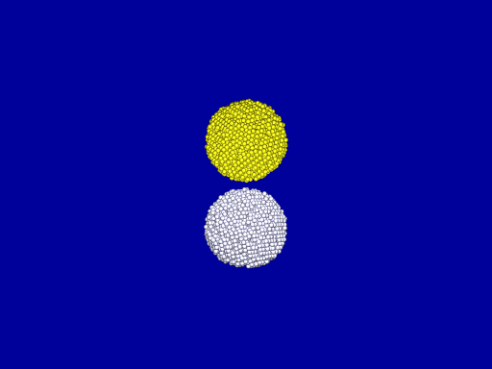
Examples of simulation (Ice)
C.N.= 11
C.N.= 8.8
u_{col} = 0.096 m/s ( E_{imp} = 0.66 E_{break} )
u_{col} = 0.096 m/s ( E_{imp} = 0.53 E_{break} )
C.N.= 5.5
C.N.= 2.8
u_{col} = 0.38 m/s ( E_{imp} = 5.3 E_{break} )
u_{col} = 0.38 m/s ( E_{imp} = 2.7 E_{break} )

Slide 12
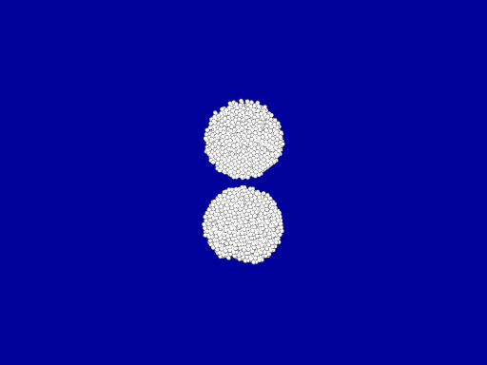
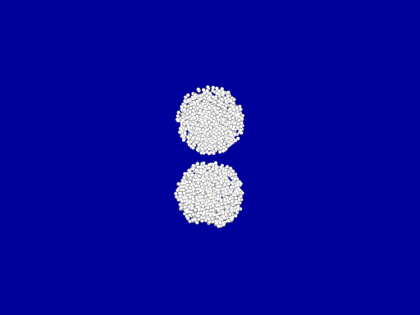
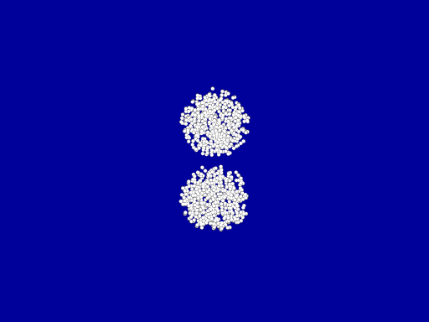
Examples of simulation (Ice)
C.N.= 11
C.N.= 8.8
u_{col} = 0.096 m/s ( E_{imp} = 0.66 E_{break} )
u_{col} = 0.096 m/s ( E_{imp} = 0.53 E_{break} )
C.N.= 5.5
C.N.= 2.8
u_{col} = 0.38 m/s ( E_{imp} = 5.3 E_{break} )
u_{col} = 0.38 m/s ( E_{imp} = 2.7 E_{break} )

Slide 13
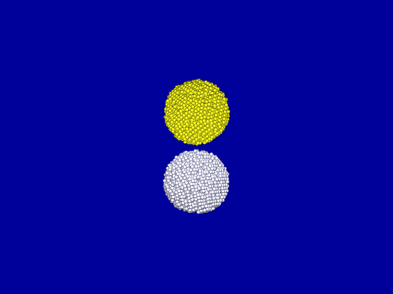
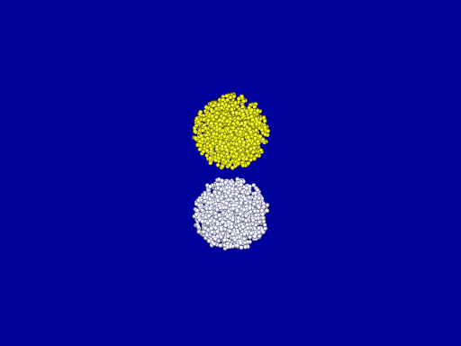
Examples of simulation (Ice)
C.N.= 11
C.N.= 8.8
u_{col} = 1.5 m/s ( E_{imp} = 170 E_{break} )
u_{col} = 1.5 m/s ( E_{imp} = 135 E_{break} )
C.N.= 5.5
C.N.= 2.8
u_{col} = 1.5 m/s ( E_{imp} = 85 E_{break} )
u_{col} = 1.5 m/s ( E_{imp} = 43 E_{break} )

Slide 14
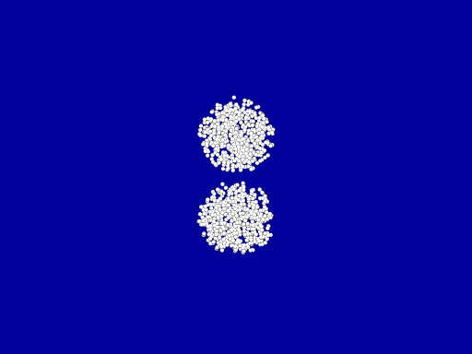
Examples of simulation (Ice)
C.N.= 11
C.N.= 8.8
u_{col} = 1.5 m/s ( E_{imp} = 170 E_{break} )
u_{col} = 1.5 m/s ( E_{imp} = 135 E_{break} )
C.N.= 5.5
C.N.= 2.8
u_{col} = 1.5 m/s ( E_{imp} = 85 E_{break} )
u_{col} = 1.5 m/s ( E_{imp} = 43 E_{break} )

Slide 15
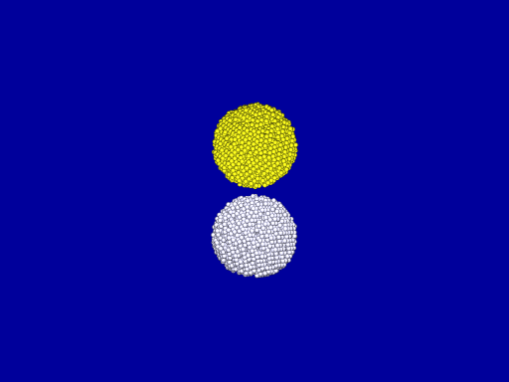
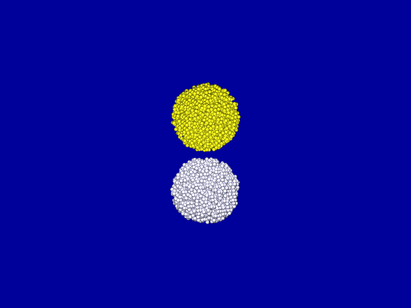
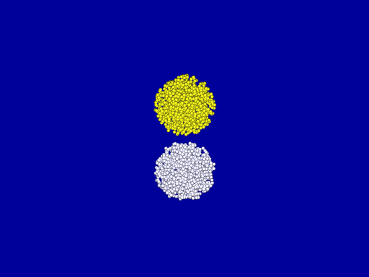
Examples of simulation (Ice)
C.N.= 11
C.N.= 8.8
u_{col} = 22 m/s ( E_{imp} = 4.1 N E_{break} )
u_{col} = 22 m/s ( E_{imp} = 4.1 N E_{break} )
C.N.= 5.5
C.N.= 2.8
u_{col} = 22 m/s ( E_{imp} = 4.1 N E_{break} )
u_{col} = 22 m/s ( E_{imp} = 4.1 N E_{break} )

Slide 16
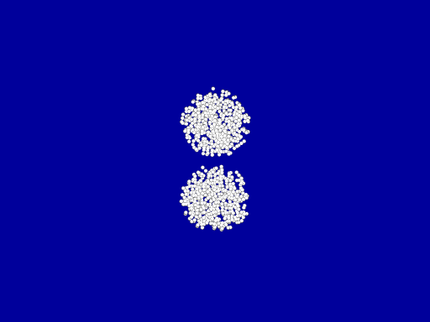
Examples of simulation (Ice)
C.N.= 11
C.N.= 8.8
u_{col} = 22 m/s ( E_{imp} = 4.1 N E_{break} )
u_{col} = 22 m/s ( E_{imp} = 4.1 N E_{break} )
C.N.= 5.5
C.N.= 2.8
u_{col} = 22 m/s ( E_{imp} = 4.1 N E_{break} )
u_{col} = 22 m/s ( E_{imp} = 4.1 N E_{break} )

Slide 17
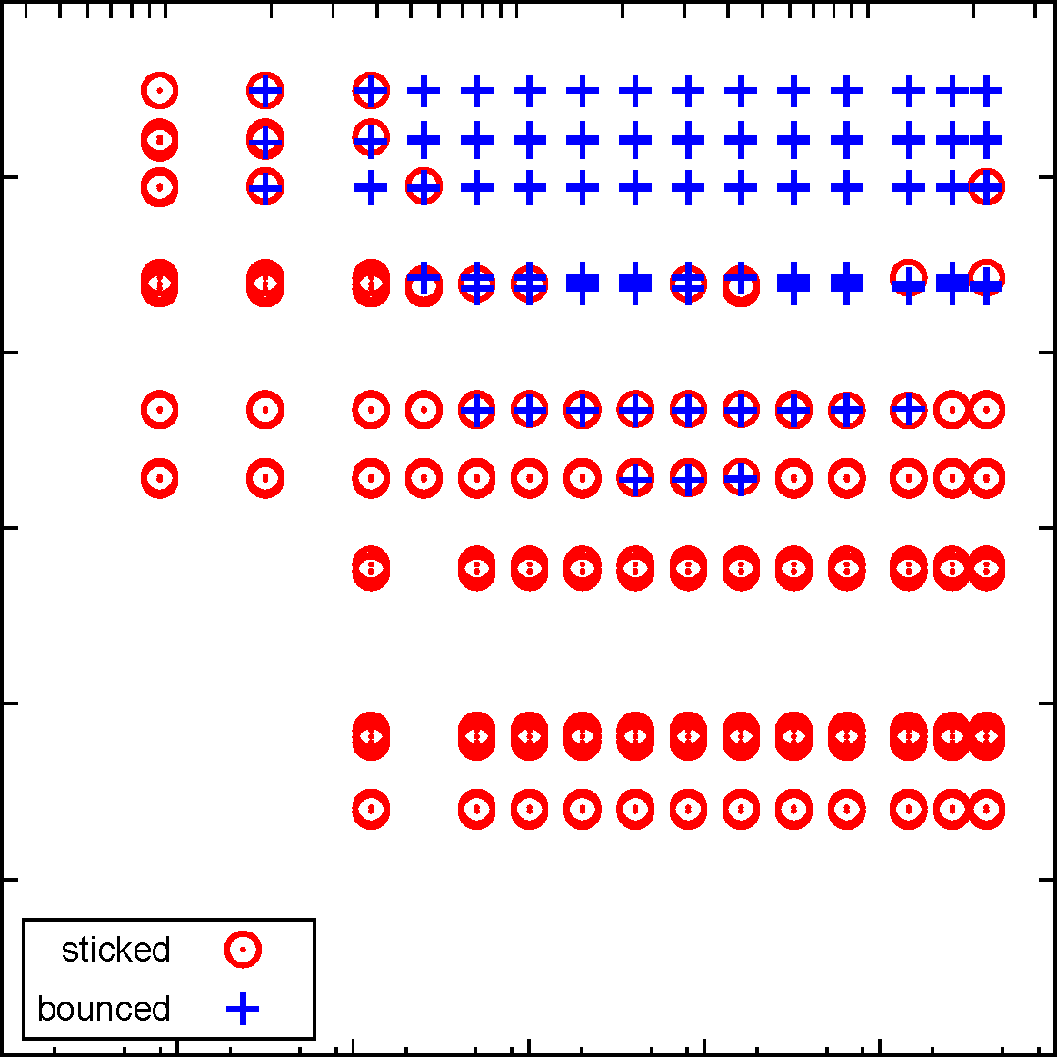
Result：Bouncing Condition (Ice)
Collision velocity [m/s]
12
0.1
1
10
Bouncing
10
8
Mean Coordination Number
Mean C.N. < ~ 6
6
4
Sticking
2
0
1e-5
1e-4
1e-3
0.01
0.1
1
10
E_{impact} / (N E_{break})

Slide 18
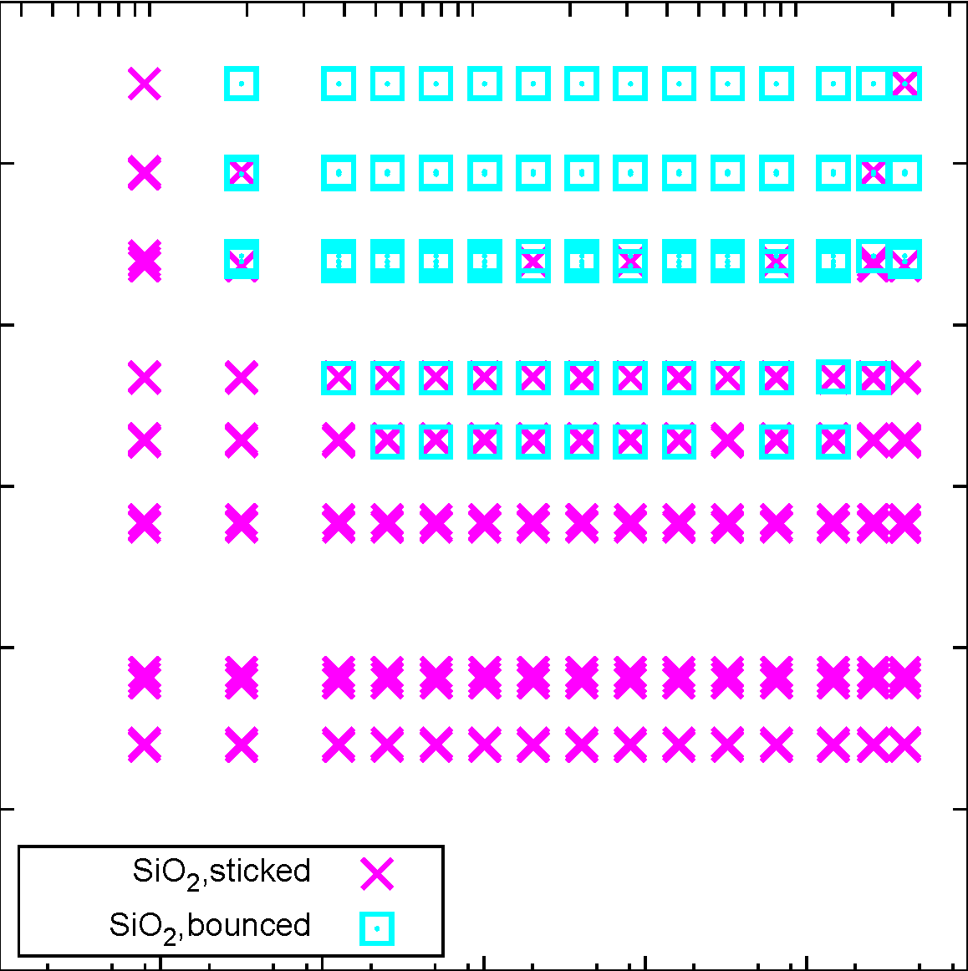
Result: Bouncing Condition (SiO₂)
Collision velocity [m/s]
12
0.01
0.1
1
Bouncing
10
8
Mean Coordination Number
Mean C.N. < ~ 6
6
4
Sticking
2
0
1e-5
1e-4
1e-3
0.01
0.1
1
10
E_{impact} / (N E_{break})

Slide 19
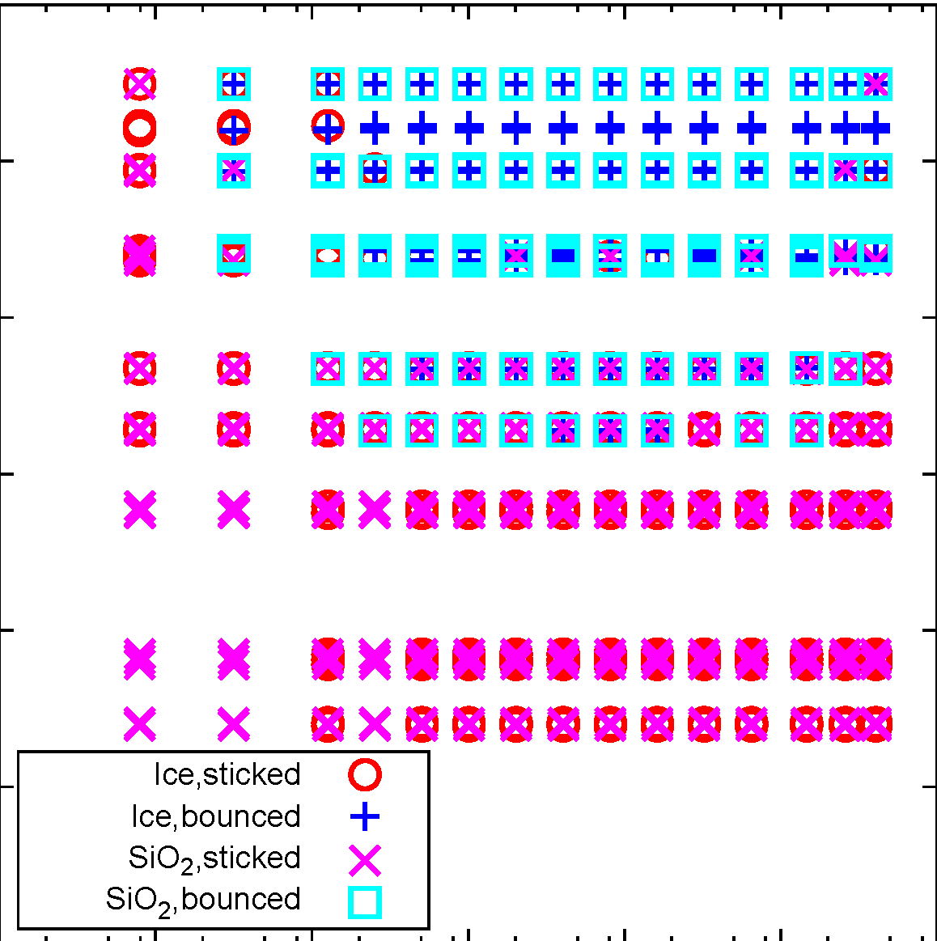
Result: Bouncing Condition (Ice, SiO₂)
12
10
No difference
between Ice and SiO₂
8
Mean Coordination Number
6
Scaled well
by using E_{break}
4
2
0
1e-5
1e-4
1e-3
0.01
0.1
1
10
E_{impact} / (N E_{break})

Slide 20
Why C.N. = 6 ?
A particle cannot move freely with C.N. = 6 in 3D:

Slide 21
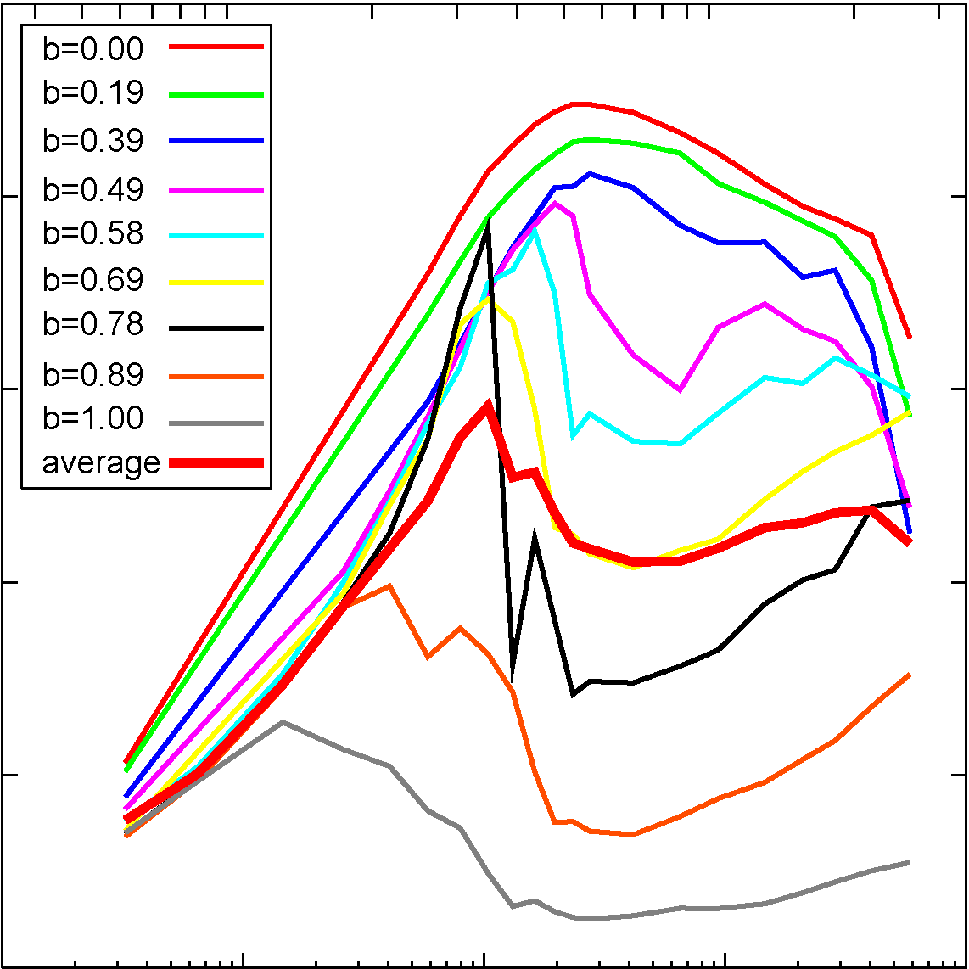
C.N.@BPCA collisions
u_{col} [m/s]
Ice, 8Å, 8000+8000
10
100
4
3.6
3.2
Mean Coordination Number
2.8
2.4
2
0.1
1
10
100
1000
E_{impact} / (N E_{break})

Slide 22
Why C.N. = 4 ?
A particle cannot move freely with C.N. = 6 in 3D:
But, stable enough with at least C.N. = 4 in 3D:
1D
2D
3D

Slide 23
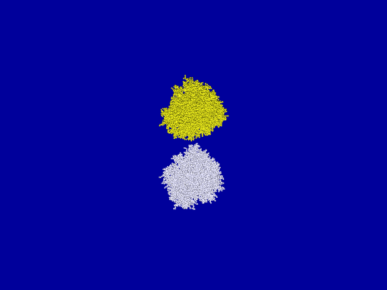
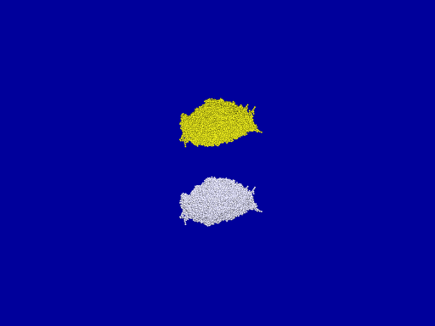
aggregates produced by collisions
BPCA, N=8000+8000, ice, ξ_{c} = 8Å, u_{col} = 57 m/s ( E_{imp} = 27 NE_{break} )
Initial condition(C.N. = 3.8）
15288+15288

Slide 24
Collisions of collision-produced aggregates（C.N.=3.8）
u_{col} = 0.38 m/s ( E_{imp} = 1.2×10⁻³ NE_{break} )
u_{col} = 0.77 m/s ( E_{imp} = 5.1×10⁻³ NE_{break} )
u_{col} = 1.54 m/s ( E_{imp} = 2.0×10⁻² NE_{break} )
u_{col} = 17.4 m/s ( E_{imp} = 2.6 NE_{break} )

Slide 25
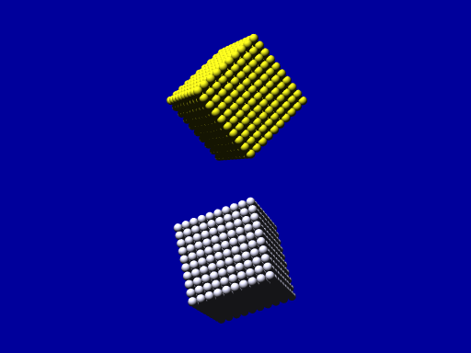
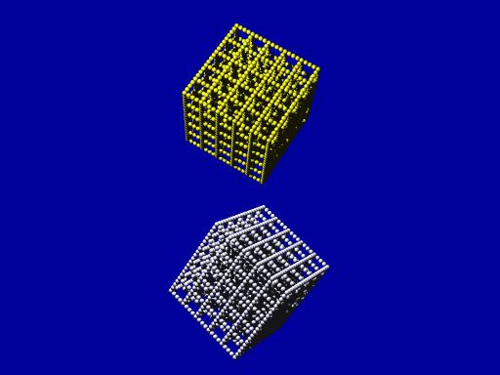
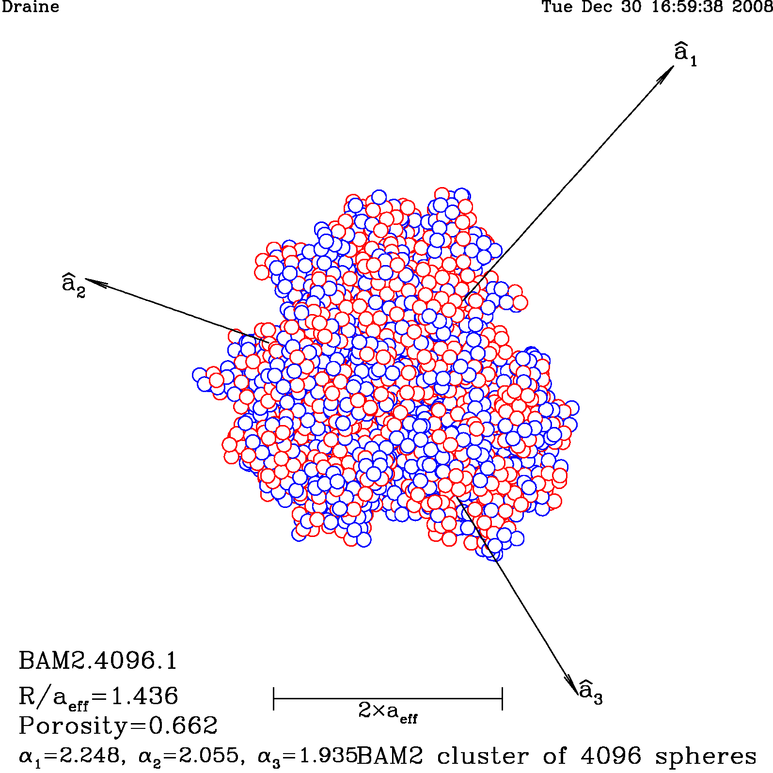
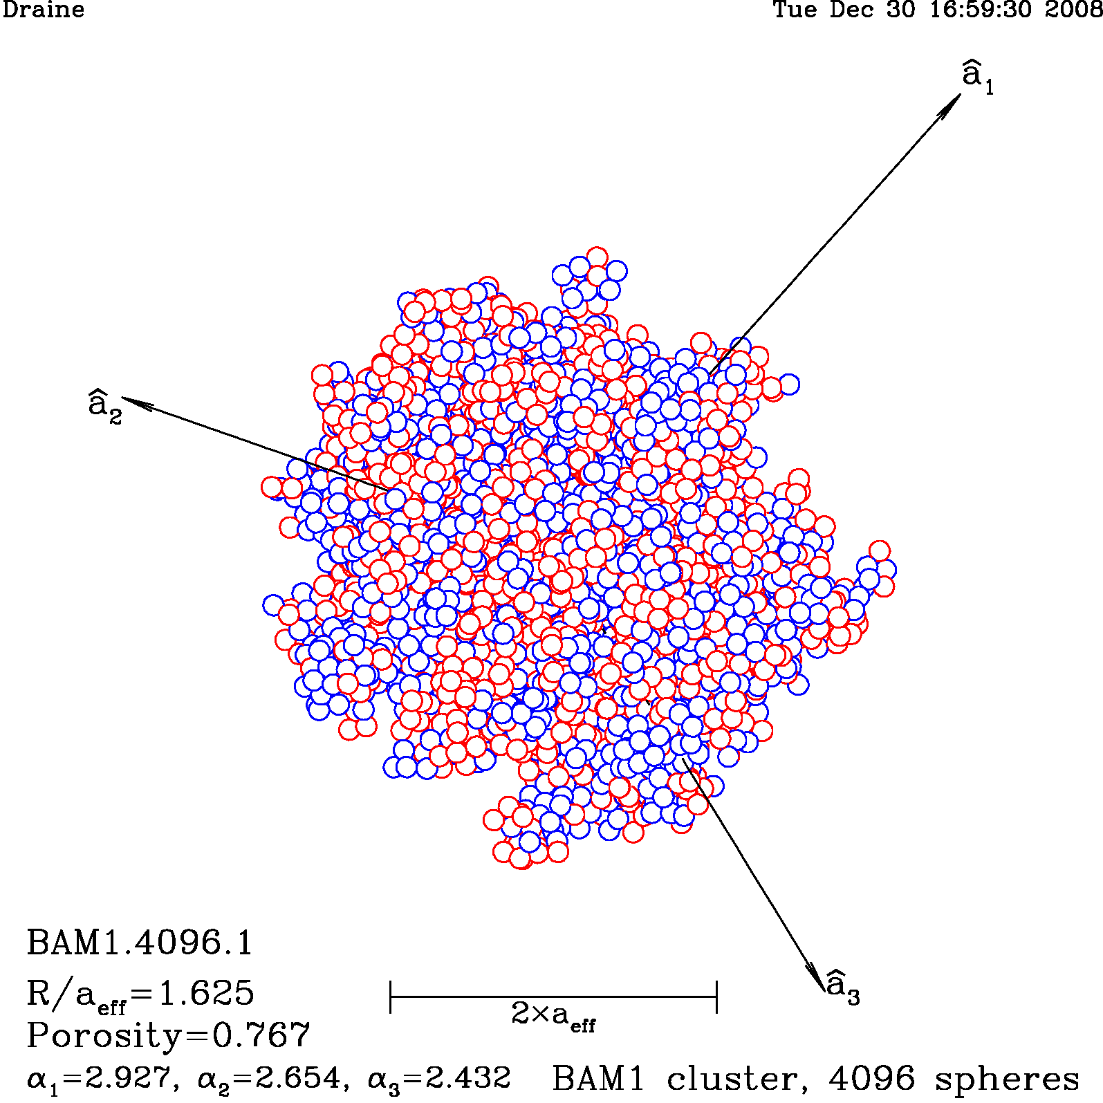
Structure is also important?
C.N. = 6
C.N. = 2.35
Cubic lattice
C.N. = 6
BAM-2
C.N. = 4
BAM-1
Ballistic Agglomeration
with Migration (BAM)
Shen, Draine, and Johnson (2008)

Slide 26
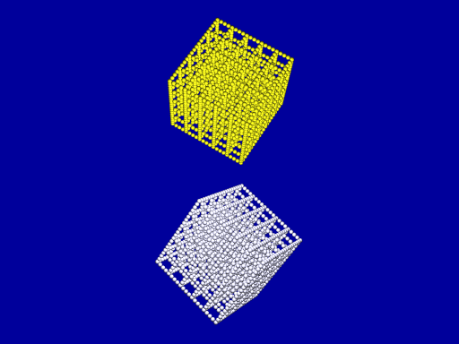
Structure is not important.
C.N. = 6
C.N. = 2.35
C.N. = 6
C.N. = 4
No!
Bouncing
only for C.N.≃6

Slide 27
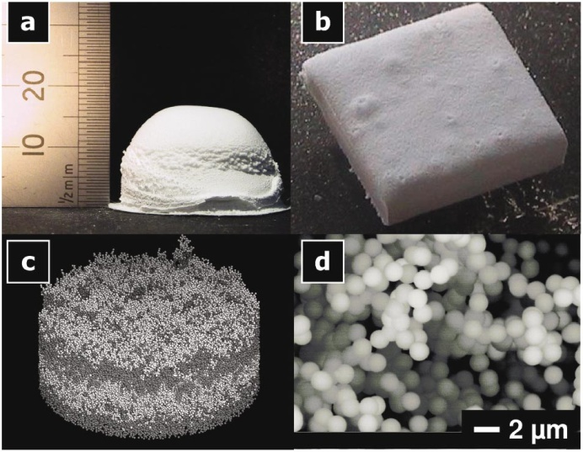
Summary
We examine the bouncing condition, focusing on C.N. of aggregates.
Always sticking if C.N. < 6.
Collision velocity for transition from bouncing to sticking is consistent with experimental results.
collision-produced aggregates have C.N. < 4
Not to bounce.
It is feasible to form planetesimals through direct collisions of dust aggregates.
C.N. ~ 2 for aggregates in experiments ?
FIG. 2 (color online). (a) An example of an agglomerate with a volume filling factor of 0:15. (b) Specimen of an agglomerate after manual cutting to 10 10 mm2. (c) Result of a Monte Carlo simulation of ballistic deposition. (d) High resolution scanning electron microscopy (SEM) image of the surface of an agglomerate consisting of SiO2 spheres with 1:5 m diameter.
(Blum & Schräpler 2004)

Slide 28
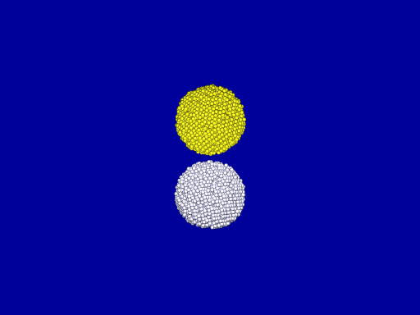
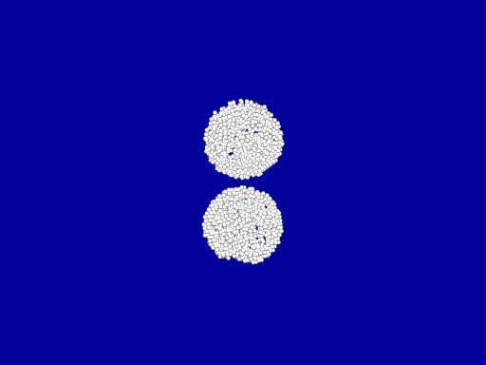
A Hard Shell ?
f = 0.75
mean C.N. = 2.8
a/b = 0.8
a
b
f = 0.2
mean C.N. = 8.8
Ice
u_{col} = 1.1 m/s (vimp = 3)

Slide 29
Collisions between
different-sized dust aggregates

Slide 30
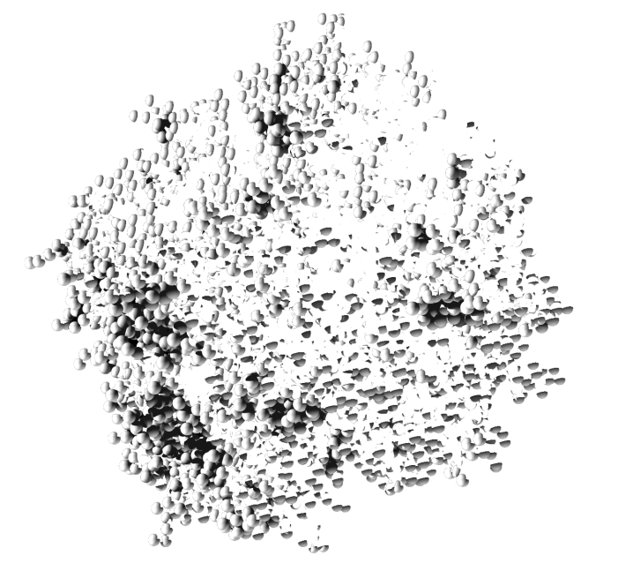
Ballistic Particle-Cluster Aggregation (BPCA)
Formed by one-by-one sticking of monomers
Compact structure (fractal dimension ~ 3)
Dust is expected to be compact
at high velocity collisions causing their disruption
Collisions of BPCA clusters
implication for growth and disruption of dust

Slide 31
Motivation
Collision velocity of dust
in protoplanetary disks
< several 10 m/s !
e.g., ＜～50 m/s (Hayashi model, without turbulence)
Is it possible for dust to grow through collisions ?
1
(ice BPCA)
Possible for ice dust
~ 60 m/s
of equal-sized aggregates
mass gain
(N_{large} – N_{target})/ N_{proj}
0
But, for silicate dust?
8000+8000
u_{coll} for silicate = 0.1×u_{coll} for ice
mass loss
2000+2000
500+500
What if different-sized?
-1
10
u_{coll} [m/s]
100
(Wada et al. 2009, ApJ 702, 1490-1501)

Slide 32
Objective
Do collisions of different-sized aggregates encourage dust growth?
Simulations of collisions between
BPCAs of different sizes
Growth efficiency: f = (N_{large} – N_{target})/ N_{proj}
Size dependence
Size-ratio dependence

Slide 33
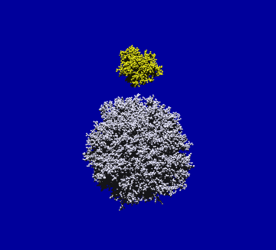
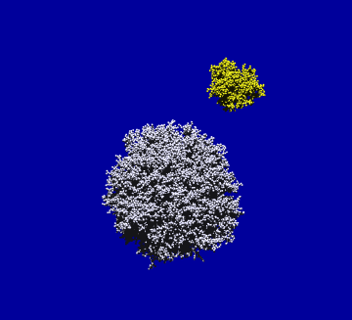
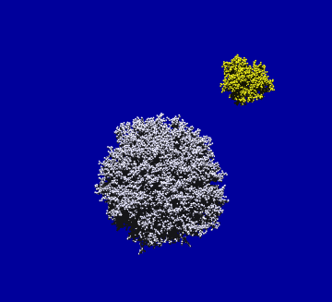
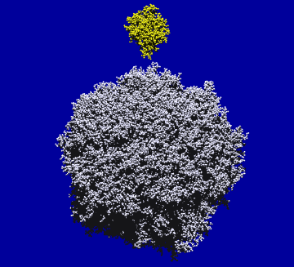
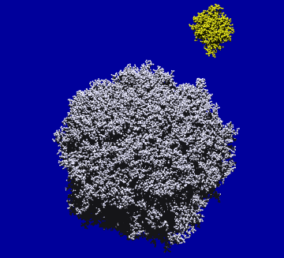
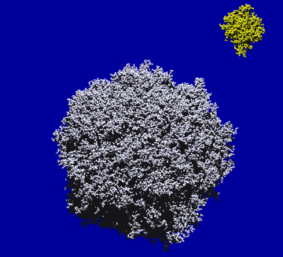
Initial Conditions and Parameters
Collisions of BPCA clusters: projectile vs. target
Size ratio = 1 : 16 (2000:32000, 8000:128000)
Impact parameter： b (defined by using characteristic radius）
1 : 64 ( 500:32000, 2000:128000, 8000:512000)
2000:32000 (= 1:16)
2000:128000 (= 1:64)
b = 0.69
b = 1
b = 0.69
b = 0
b = 1
b = 0
Ice (E = 7.0⋅10¹⁰ Pa, ν = 0.25, γ = 100 mJ/m², R = 0.1μm) , critical rolling displace. ξ_{crit} = 8Å
Collision velocity u_{coll} = 15 - 300 m/s

Slide 34
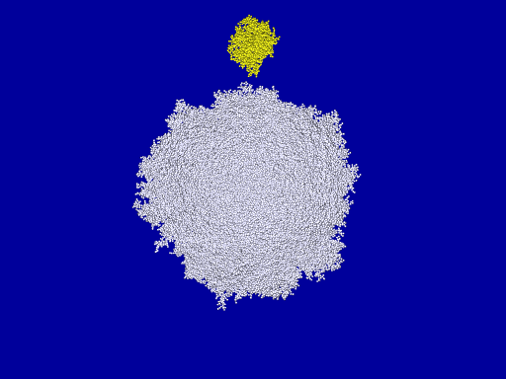
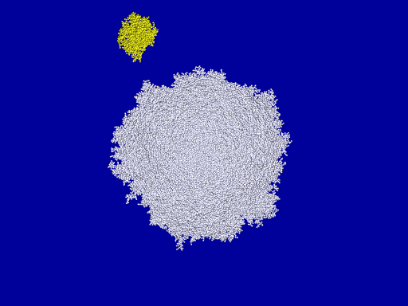
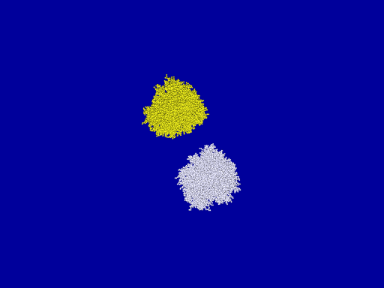
Examples of simulations
2000 : 128000 (= 1 : 64)
ice, u_{coll} = 52 m/s
b = 0
b = 0.69
effectively captured
8000 : 8000
8000 : 8000
b = 0
b = 0.69

Slide 35
Growth efficiency
(ice)
f ≡ (N_{large} – N_{target})/ N_{proj}
1
: growth efficiency
f > 0
mass gain
f < 0
mass loss
f = (N_{large} – N_{target})/ N_{proj}
0
8000 : 8000 = 1 : 1
-1
10
100
u_{coll} [m/s]

Slide 36
Growth efficiency
(ice)
f ≡ (N_{large} – N_{target})/ N_{proj}
1
: growth efficiency
f > 0
mass gain
f < 0
mass loss
f = (N_{large} – N_{target})/ N_{proj}
0
8000 : 8000 = 1 : 1
8000 : 8000 = 1 : 1
2000 : 32000 = 1 : 16
-1
10
100
u_{coll} [m/s]

Slide 37
Growth efficiency
(ice)
f ≡ (N_{large} – N_{target})/ N_{proj}
1
: growth efficiency
f > 0
mass gain
f < 0
mass loss
No size dependence
f = (N_{large} – N_{target})/ N_{proj}
0
8000 : 8000 = 1 : 1
2000 : 32000 = 1 : 16
8000 : 128000 = 1 : 16
-1
10
100
u_{coll} [m/s]

Slide 38
Growth efficiency
(ice)
f ≡ (N_{large} – N_{target})/ N_{proj}
1
: growth efficiency
f > 0
mass gain
f < 0
mass loss
f = (N_{large} – N_{target})/ N_{proj}
0
8000 : 8000 = 1 : 1
2000 : 32000 = 1 : 16
8000 : 128000 = 1 : 16
500 : 32000 = 1 : 64
-1
10
100
u_{coll} [m/s]

Slide 39
Growth efficiency
(ice)
f ≡ (N_{large} – N_{target})/ N_{proj}
1
: growth efficiency
f > 0
mass gain
f < 0
mass loss
f = (N_{large} – N_{target})/ N_{proj}
0
8000 : 8000 = 1 : 1
8000 : 8000 = 1 : 1
2000 : 32000 = 1 : 16
2000 : 32000 = 1 : 16
8000 : 128000 = 1 : 16
8000 : 128000 = 1 : 16
500 : 32000 = 1 : 64
2000 : 128000 = 1 : 64
-1
10
100
u_{coll} [m/s]

Slide 40
Growth efficiency
(ice)
f ≡ (N_{large} – N_{target})/ N_{proj}
1
: growth efficiency
f > 0
mass gain
f < 0
mass loss
No size dependence
f = (N_{large} – N_{target})/ N_{proj}
0
8000 : 8000 = 1 : 1
Dependent on size ratio
8000 : 8000 = 1 : 1
2000 : 32000 = 1 : 16
2000 : 32000 = 1 : 16
The larger ratio, the more gain.
8000 : 128000 = 1 : 16
8000 : 128000 = 1 : 16
500 : 32000 = 1 : 64
No increase
in the critical velocity
(< 100 m/s)
2000 : 128000 = 1 : 64
8000 : 512000 = 1 : 64
-1
10
100
u_{coll} [m/s]

Slide 41
Summary and Implication
Simulations of collisions of different-sized BPCAs
Large size-ratio leads to large growth efficiency.
encouraging dust growth and planetesimal formation
The critical collision velocity u_{coll,crit} is unchanged.
u_{coll,crit} for ice < 100 m/s
u_{coll,crit} for silicate = 0.1×u_{coll,crit} for ice
< 10 m/s
It is still difficult for silicate dust to grow?

Slide 42
Take-home messages
for Low-velocity collisions
Does “bouncing barrier” for dust growth really exist?
No!
for high-velocity collisions
Do collisions between different-sized aggregate encourage dust growth?
Partly Yes,
But, not enough for silicate dust.
Can dust grow through collisions?

Slide 44
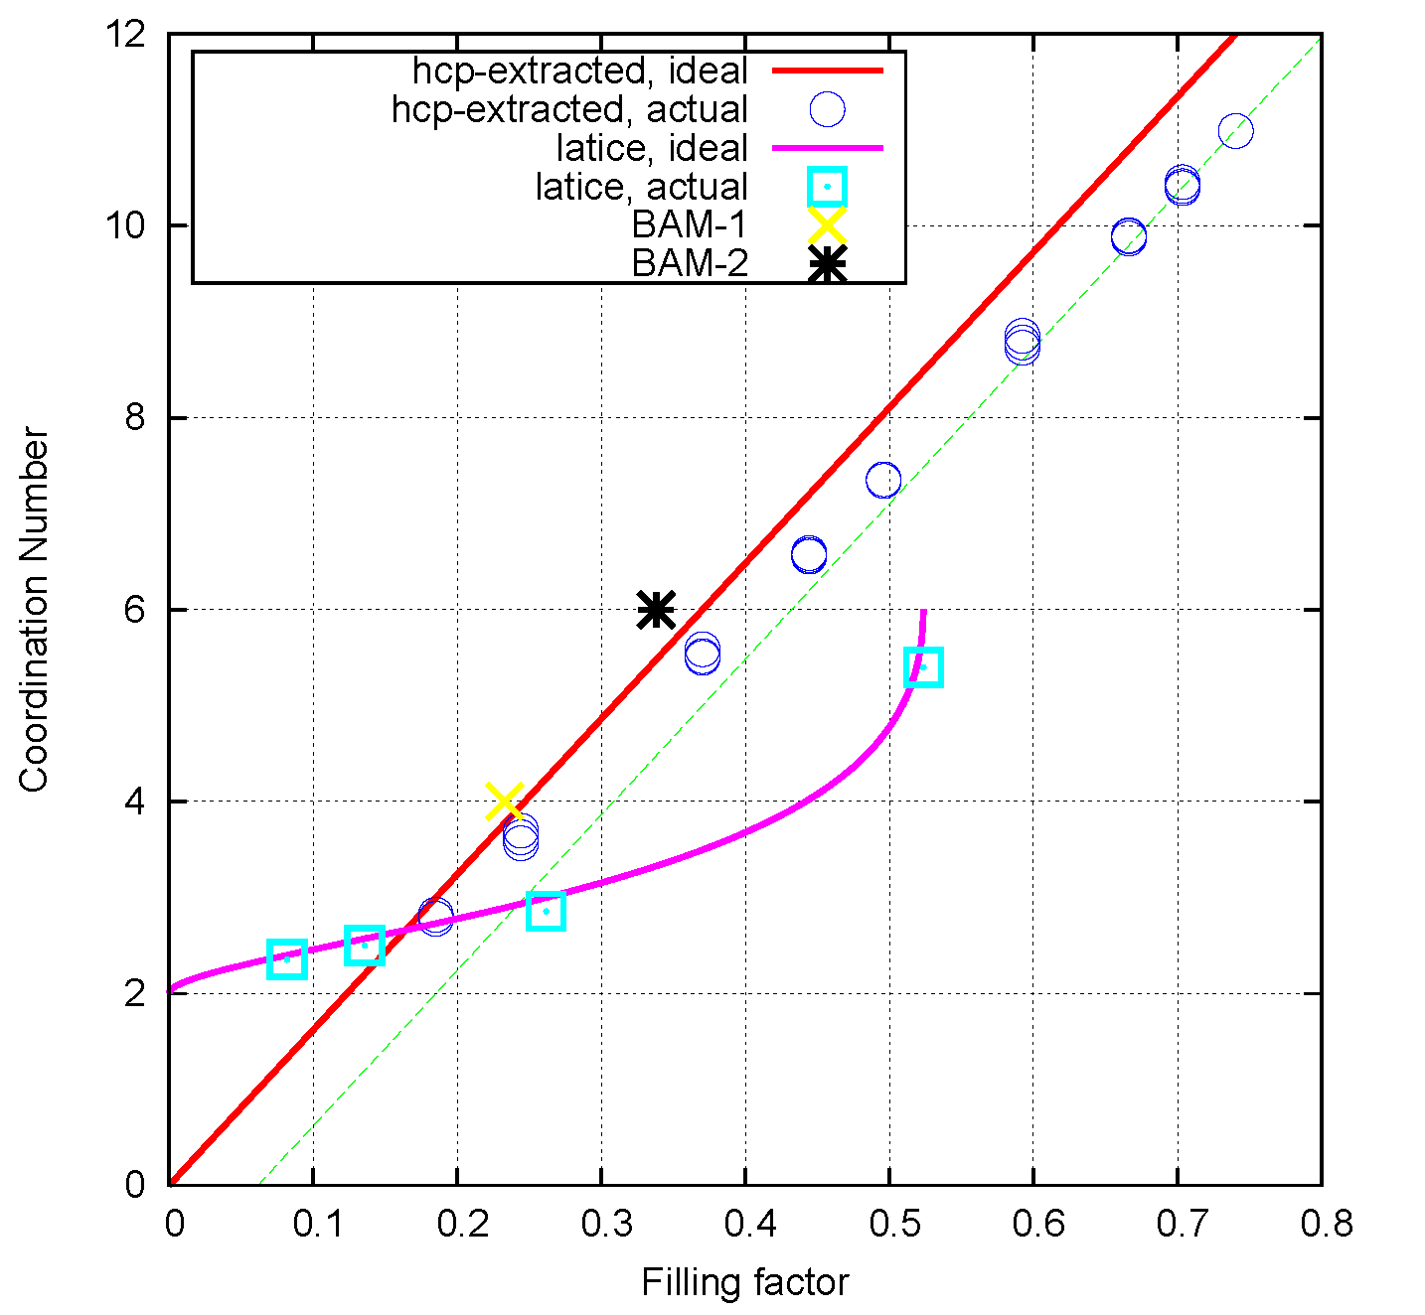

Slide 46
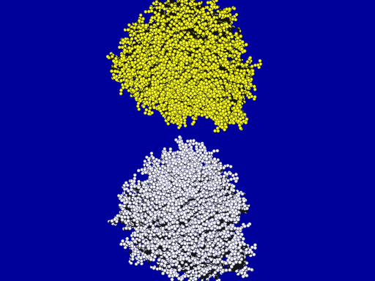
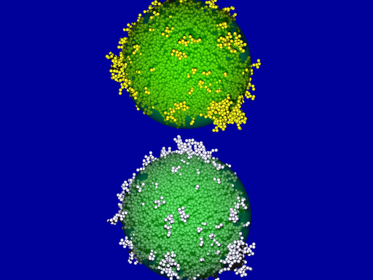
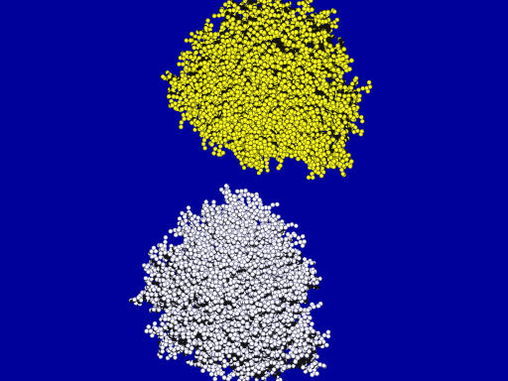
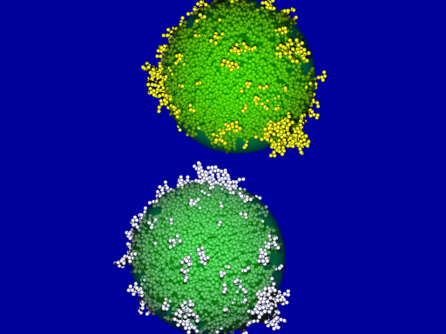
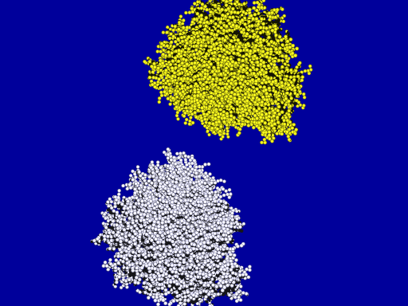
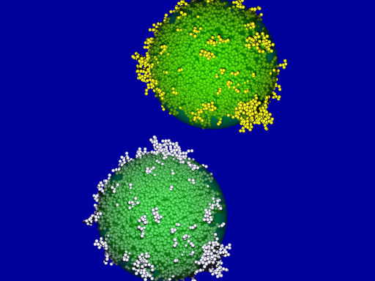
Initial Conditions and Parameters
Collisions of BPCA clusters
Results are averaged
BPCA clusters are:
composed of 500, 2000, or 8000 particles (3 types randomly produced)
Impact parameter： b (defined by using characteristic radius r_{c}）
b = 0.19
b = 0.39
b = 0.49
b = 0.58
b = 0.69
b = 0.77
b = 0.89
b = 1.00
b = 0
l
ｒ_{ｃ,b}
ｒ_{ｃ,a}
8000+8000
Ice (E = 7.0⋅10¹⁰ Pa, ν = 0.25, γ = 100 mJ/m², R = 0.1μm) , critical rolling displace. ξ_{crit} = 8Å
Impact velocity v_{imp}= 6 - 300 m/s

Slide 47
Collisions of BPCA clusters
N=8000+8000, ice, ξ_{c} = 8Å, v_{imp} = 70 m/s ( E_{imp} = 42 NE_{break} )
b = 0
b = 0.39
b = 0.69
b = 1.00

Slide 48
Largest fragment mass N_{large}: growth efficiency
v_{imp} [m/s]
(ice)
10
100
f ≡ N_{large} / N_{total}
1
b = 0.00
: growth efficiency
8000+8000
0.8
f > 0.5
+ growth
f < 0.5
- growth
0.6
f = N_{large} / N_{total}
2000+2000
0.4
dependent on N
500+500
0.2
0
0.1
1
10
100
1000
E_{impact} / (N E_{break})

Slide 49
Probability of collisions within [b, b+db]
l
∴
P(b) db = 2b db (0 ≤ b ≤ 1)
= db² (0 ≤ b² ≤ 1)
Average value of f
2r_{c}

Slide 50
Growth efficiency: f (b²)
f as a function of b²
f ≡ N_{large} / N_{total}
: growth efficiency
1
f > 0.5
+ growth
0.8
f < 0.5
- growth
f = N_{large} / N_{total}
0.6
0.4
0.2
0
0
0.2
0.4
0.6
0.8
1.0
b²

Slide 51
Largest fragment mass N_{large}: growth efficiency
v_{imp} [m/s]
(ice)
10
100
f ≡ N_{large} / N_{total}
1
8000+8000
: growth efficiency
0.8
f > 0.5
+ growth
f < 0.5
- growth
0.6
f = N_{large} / N_{total}
0.4
Average
weighted by b²
0.2
0
0.1
1
10
100
1000
E_{impact} / (N E_{break})

Slide 52
Growth efficiency averaged
v_{imp} [m/s]
Averaged for b²
(ice)
10
100
f ≡ N_{large} / N_{total}
1
8000+8000
: growth efficiency
0.8
f > 0.5
+ growth
f < 0.5
- growth
0.6
f = N_{large} / N_{total}
0.4
0.2
0
0.1
1
10
100
1000
E_{impact} / (N E_{break})

Slide 53
Growth efficiency averaged
v_{imp} [m/s]
Averaged for b²
(ice)
10
100
f ≡ N_{large} / N_{total}
1
: growth efficiency
0.8
~ 60 m/s
f > 0.5
+ growth
f < 0.5
- growth
0.6
f = N_{large} / N_{total}
0.4
small dependence on N
0.2
0
0.1
1
10
100
1000
E_{impact} / (N E_{break})

Slide 54
Averaged growth efficiency for BCCA clusters
v_{imp} [m/s]
(ice)
Averaged over b²
10
100
1
independent of N
0.8
~ 37 m/s
0.6
f = N_{large} / N_{total}
0.4
0.2
0
0.1
1
10
100
1000
E_{impact} / (N E_{break})

Slide 55
Averaged growth efficiency : BCCA & BPCA
v_{imp} [m/s]
(ice)
Averaged over b²
10
100
1
40 ~ 60 m/s
0.8
Actual dust structure:
between BCCA and BPCA
0.6
f = N_{large} / N_{total}
BCCA
BPCA
0.4
0.2
0
0.1
1
10
100
1000
E_{impact} / (N E_{break})

